Slide 1
Code Vulnerability Detection with Graph Learning Approaches
Keenan Flynn, Ruoyao Xiao (Eric),
Mustavi Islam, Hoyun Yoon
Notes:
Mustavi

Slide 2
Introduction
Graph Learning
Vulnerability Detection
Classification of CWEs
Graph representation of Text
Notes:
Mustavi

Slide 3
Problem Statement
Vulnerability Detection is an important topic in security area.
Average data breach costs 3.86$ Million
Massive amount of data
Unable to identify manually
Notes:
Mustavi

Slide 4
Previous work
NLP approaches to detect vulnerabilities in code
LSTMs and RNNs assume ordered data
  Limitation: Code doesn’t always execute in an ordered sequence
Notes:
Keenan

Slide 5
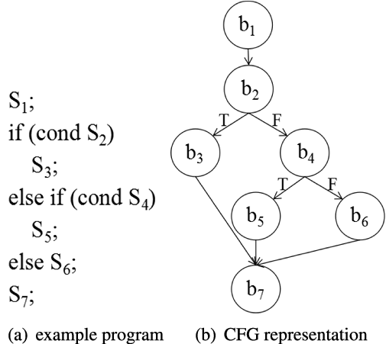
Challenges
How to represent the non-linearity of program sequences
Solution: Control Flow Graphs
Notes:
Keenan

Slide 6
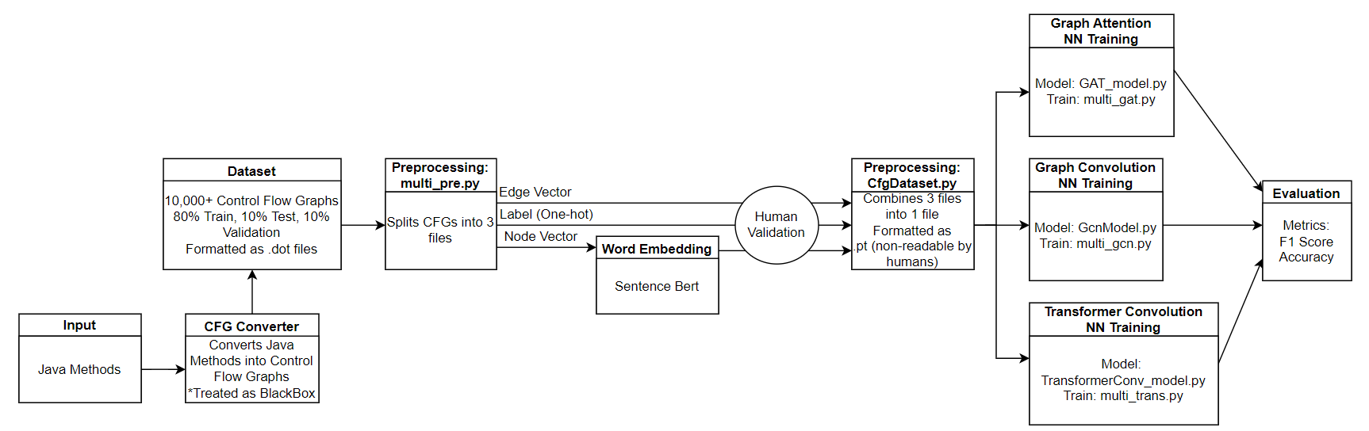
Solution Pipeline
Notes:
Keenan

Slide 7
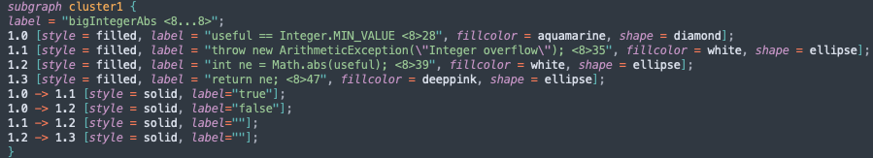
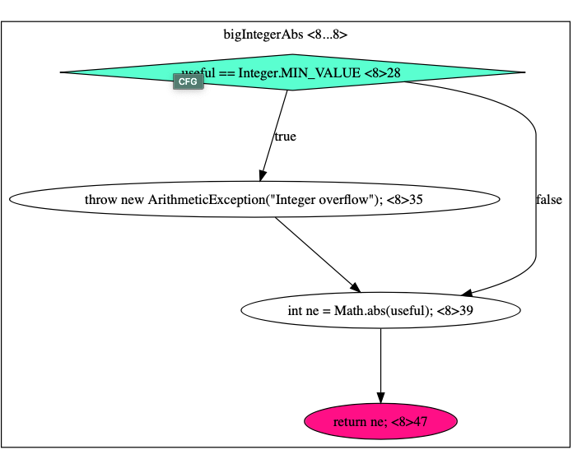
Approaches
Raw Data: Control Flow Graph (CFG)
Model: GAT, GCN, TCN
Notes:
Eric

Slide 8
Implementation
Convert dot file to
.adj (edge) .gf (graphlabel) .ndf (nodelabel)
CFGDataset : Combined those three kinds of files to the file that models can learn
Sentence Transformer
Notes:
Eric

Slide 9
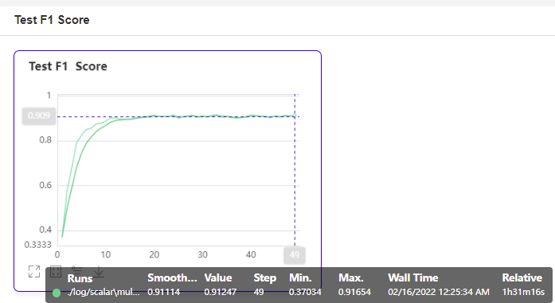
Result for GAT – 91.7%
Notes:
Hoyun

Slide 10
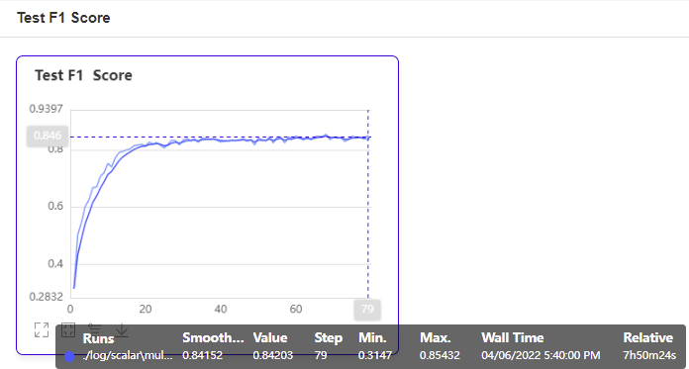
Result for GCN – 85.4%
Notes:
Hoyun

Slide 11
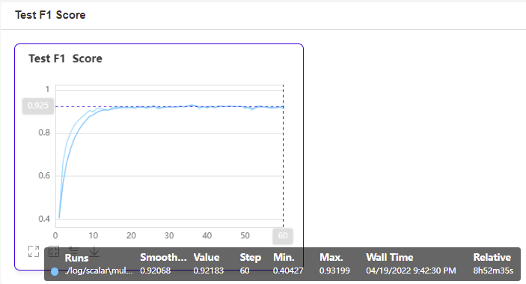
Result for TCN – 93.2%
Notes:
Hoyun

Slide 12
Moving Forward
Hyper-parameter Tuning
Exploration of other GNN algorithms
Change approach of word embedding

Slide 13
Q & A

Slide 14
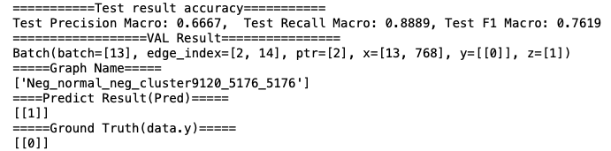
Result & Conclusion
sdasd

Slide 15
References
Thomas N, Max Welling, Semi-Supervised classification with graph convolution Networks
Graph Attention Networks

